Slide 1
Machine Learning
ML Workflow – Steps and procedures

Slide 2
WHY?
Real Life Example

Slide 3
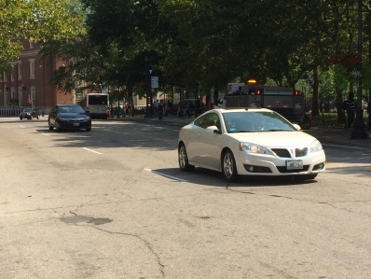
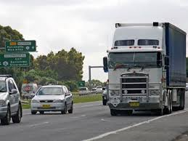
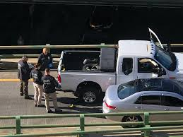
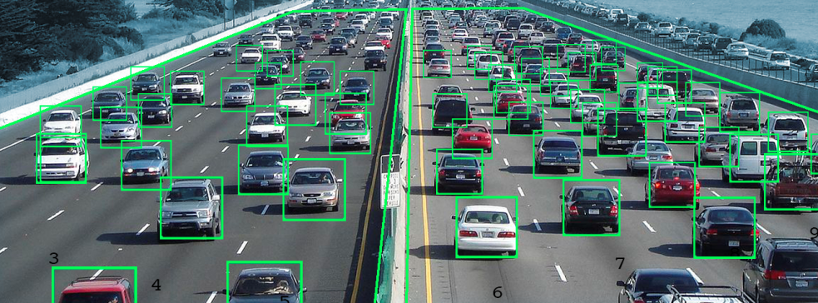
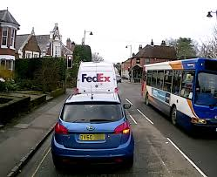
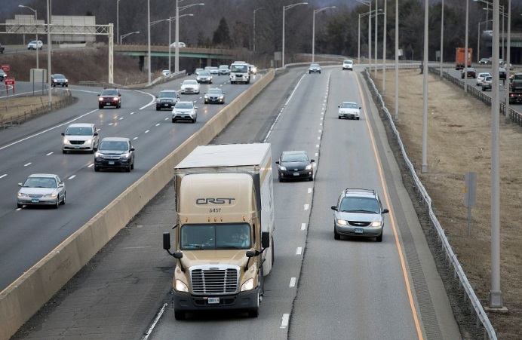
REAL life example – truck or no truck
Data

Slide 4
REAL life example – truck or no truck
Known data
Labels

Slide 5
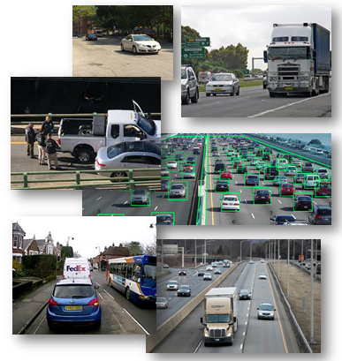
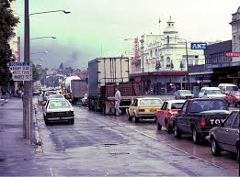
REAL life example – truck or no truck
Known data
Labels
New Data

Slide 6
REAL life example – truck or no truck
Known data
Labels
New Data
?

Slide 7
REAL life example – truck or no truck
Known data, aka:
Training Set
Labeled data
Etc
Labels
New Data, aka:
Test Set
Real world data
Etc
?

Slide 8
REAL life example – truck or no truck
OFTEN wrong names
Known data, aka:
Training Set
Labeled data
Etc
Labels
New Data, aka:
Test Set
Real world data
Etc
?

Slide 9
HOw?
Machine learning process

Slide 10

Model
Label

Slide 11
Machine Learning Workflow
Data Processing
&
Feature Selection
Training
Info on Model
”Real Life”
Data
Trained
Model
Label

Slide 12
Machine Learning Workflow
Data Processing
&
Feature Selection
Training
Model Selection
Testing
Quality of Model
”Real Life”
Data
Trained
Model
Label

Slide 13
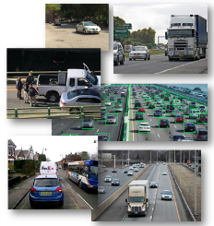
Classification in Machine learning
How many questions can we pull from this schema?
Data Source
Python Server
Tableau Dashboards
?

Slide 14
Classification in Machine learning
How many questions can we pull from this schema?
What is inside this model?
Data Source
Python Server
Tableau Dashboards
?
Which columns, how many?
How do we choose the model?
What is the accuracy of this result?

Slide 15
What?
Machine learning process

Slide 16
Machine learning workflow operations
K-fold cross validation
Mutual Information
Training Data
Cross validation
Test Set
Feature Selection
Mutual Information

Slide 17
Machine learning process
Feature Selection

Slide 18
Machine learning workflow operations – Feature Analysis
Data Source
Processed Data
What is each column?

Slide 19
Machine learning workflow operations – Feature Analysis
Data Source
Processed Data
max(Y-axis)
Perimeter
max(X-axis)
Area

Slide 20

Machine learning workflow operations – Feature Analysis
Data Source
Processed Data
Number of employees
Year of foundation
Yearly Revenues
Industry Sector

Slide 21
Feature Selection…
… more on this later on

Slide 22
Machine learning process
Training

Slide 23
Machine learning workflow operations – TRAINING
KNN
Decision Trees
Random Forest
M.L.P.
Expectation-Maximization
Neural Networks
S.V.M.

Slide 24
Machine learning workflow operations – TRAINING
Data Source
Processed Data
Python Server

Slide 25
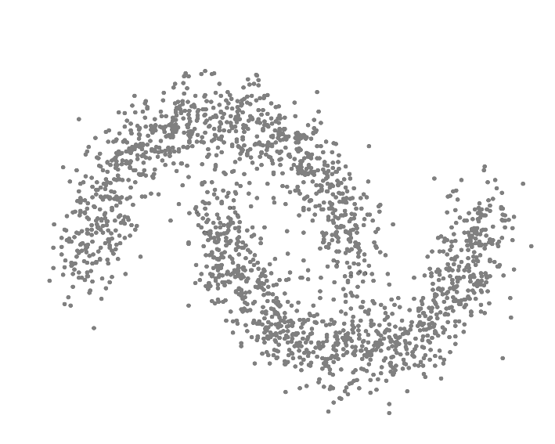
Machine learning workflow operations – TRAINING
Labels
Known data

Slide 26
Machine learning workflow operations – TRAINING
Size
Known data
Speed

Slide 27
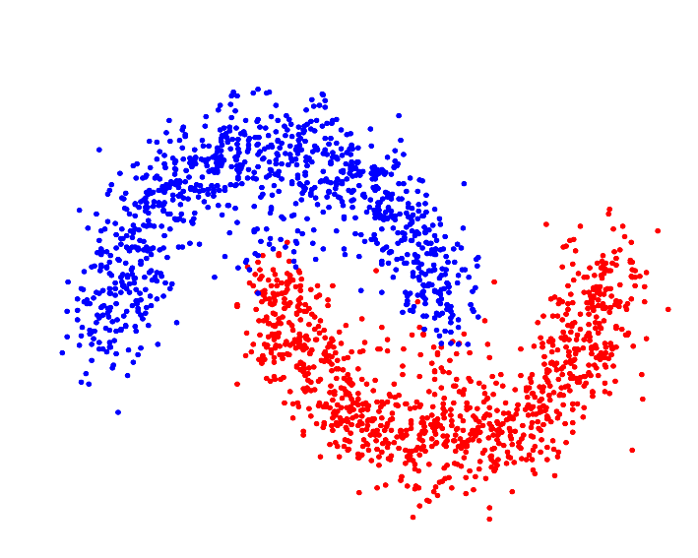
Machine learning workflow operations – TRAINING
Size
Known data
Labels
Speed

Slide 28
Machine learning workflow operations – TRAINING
Size
Known data
Labels
Speed
?
New Data
?

Slide 29
Machine learning workflow operations – TRAINING
Size
Known data
Labels
Speed
?
New Data
?

Slide 30
Machine learning workflow operations – TRAINING
Size
Known data
Labels
Speed
?
New Data
?

Slide 31
Machine learning workflow operations – TRAINING
Size
Dont think just about KNN
Known data
Labels
Speed
?
New Data
?

Slide 32
Machine learning process
MODEL SELECTION

Slide 33
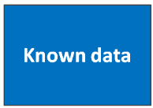
Machine learning workflow operations – Model Selection
KNN
Known data
SVM
Regression

Slide 34

Model selection – we can only pick one

Slide 35
Machine learning workflow operations – Model Selection
KNN
?
Known data
SVM
?
Regression
?

Slide 36
Machine learning workflow operations – Model Selection
KNN
?
Known data
SVM
Not enough
?
Regression
?

Slide 37
Machine learning workflow operations – Model Selection
KNN
?
Labels
Known data
=
86%
SVM
?
Labels
=
89%
Regression
?
Labels
=
50%

Slide 38
Machine learning workflow operations – Model Selection
KNN
?
Labels
Known data
=
86%
SVM
Not enough
?
Labels
=
89%
Regression
?
Labels
=
50%

Slide 39
Machine learning workflow operations – Model Selection
Known data
Labels
?
=

Slide 40
Machine learning workflow operations – Model Selection
Known data
Labels
?
=

Slide 41
Machine learning workflow operations – Model Selection
Known data
Labels
?
=
86%
Validation Set

Slide 42
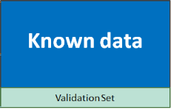
Machine learning workflow operations – Model Selection
Known data
Labels
Cars
?
=
86%
Trucks
Validation Set

Slide 43
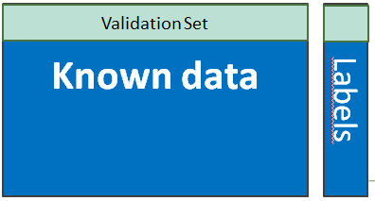

Machine learning workflow operations – Model Selection
?
=
86%

Slide 44
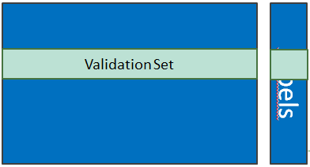
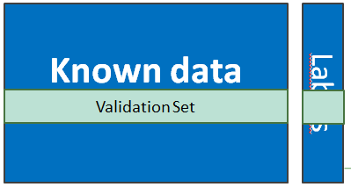
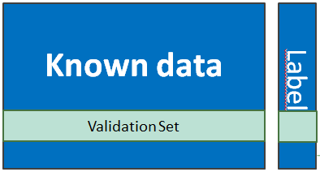

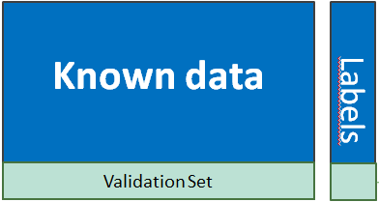
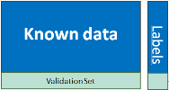
Machine learning workflow operations – Model Selection
?
=
86%
?
=
89%
?
=
80%

Slide 45
Machine learning workflow operations – Model Selection
?
=
86%
CROSS-VALIDATION
?
=
89%
?
=
80%

Slide 46
Machine learning workflow operations – Model Selection
KNN
?
Known data
=
86%
Cross Validation

Slide 47
Machine learning workflow operations – Model Selection
KNN
?
Known data
=
86%
SVM
?
Cross Validation
=
80%

Slide 48
Machine learning workflow operations – Model Selection
KNN
?
Known data
=
86%
SVM
?
Cross Validation
=
80%
Regression
?
=
62%

Slide 49

Model selection – we can only pick one
Actually no… but that is a fairly advanced topic we will leave for later

Slide 50
Now, our model is
trained and picked
and
ready to classify new data. True

Slide 51
Now, our model is
trained and picked
and
ready to classify new data. True
But can we say how good it is?

Slide 52
Machine learning process
TEST SET

Slide 53
Machine learning workflow operations – Model Selection
KNN
?
Known data
=
86%
SVM
?
Cross Validation
=
80%
Regression
?
=
62%

Slide 54
Machine learning workflow operations – Model Selection
KNN
?
Known data
=
86%
SVM
?
Cross Validation
Can we say how good it is?
=
80%
Regression
?
=
62%

Slide 55
Machine learning workflow operations – Model Selection
KNN
?
Known data
=
86%
SVM
Not enough
?
Cross Validation
=
80%
Regression
?
=
62%

Slide 56
Machine learning workflow operations – Test Set
KNN
Known data
?
=
79%
Test Set

Slide 57
Machine learning workflow operations – Lets Review
0
Known data
Labels
1000

Slide 58
Machine learning workflow operations – Lets Review
0
Known data
Labels
0
Training Set
Labels
700
0
Test Set
Labels
1000
300

Slide 59
Machine learning workflow operations – Lets Review
0
Known data
Labels
0
Training Set
Labels
Validation Set
Validation Set
Validation Set
Validation Set
Validation Set
700
0
Test Set
Labels
1000
300

Slide 60
Machine Learning Workflow
Data Processing
&
Feature Selection
Training
Model Selection
Testing
Quality of Model
”Real Life”
Data
Trained
Model
Label

Slide 61
Performance Metrics
Lets evaluate our model

Slide 62
Machine learning workflow– Performance Metrics
True Positive
Classes
Confusion Matrix
False Positive Rate
Specificity
F1 score
Precision

Slide 63
Machine learning process
ACCURACY

Slide 64
Machine learning workflow– Performance Metrics
Accuracy:
Labels
Predict answers

Slide 65
Machine learning workflow– Performance Metrics
Labels
Accuracy:
Predict answers

Slide 66
Machine learning workflow– Performance Metrics
Accuracy:
Labels
0 | 1 | 1 | 1 | 0 | 0 | 1 | 0 | 1 | 0
Predicted Answers
0 | 1 | 0 | 1 | 0 | 0 | 1 | 0 | 1 | 0
Accuracy: (# grey cells / # total) – 90%

Slide 67
Machine learning workflow– Performance Metrics
Accuracy (for several classes):
Labels
0 | 1 | 2 | 1 | 2 | 0 | 1 | 2 | 1 | 0
Predicted Answers
0 | 1 | 0 | 1 | 2 | 0 | 0 | 2 | 1 | 2

Slide 68
Machine learning workflow– Performance Metrics
Accuracy (for several classes):
Labels
0 | 1 | 2 | 1 | 2 | 0 | 1 | 2 | 1 | 0
Predicted Answers
0 | 1 | 0 | 1 | 2 | 0 | 0 | 2 | 1 | 2
Accuracy: (# grey cells / # total) – 70%

Slide 69
Machine learning process
CONFUSION MATRIX

Slide 70
Machine learning workflow– Classification matrix
Lets say our Test set had 1000 entries…

Slide 71
Machine learning workflow– CONFUSION matrix
Lets say our Test set had 1000 entries...
Predicted Labels (output of the model)
Correct Labels
(provided in the data)

Slide 72
Machine learning workflow– Classification matrix
Lets say our Test set had 1000 entries…
Predicted Labels (output of the model)
A
Correct Labels
(provided in the data)

Slide 73
Machine learning workflow– Classification matrix
Lets say our Test set had 1000 entries…
Predicted Labels (output of the model)
 | A
A
Correct Labels
(provided in the data)

Slide 74

Machine learning workflow– Classification matrix
Lets say our Test set had 1000 entries…
Predicted Labels (output of the model)
 | A
A | 266
Correct Labels
(provided in the data)

Slide 75

Machine learning workflow– Classification matrix
Lets say our Test set had 1000 entries…
Predicted Labels (output of the model)
 | A | B | C
A | 266 | 21 | 30
Correct Labels
(provided in the data)

Slide 76
Machine learning workflow– Classification matrix
Lets say our Test set had 1000 entries…
Predicted Labels (output of the model)
 | A | B | C
A | 266 | 21 | 30
B |  | 289
Correct Labels
(provided in the data)

Slide 77
Machine learning workflow– Classification matrix
Lets say our Test set had 1000 entries…
Predicted Labels (output of the model)
 | A | B | C
A | 266 | 21 | 30
B |  | 289
C |  |  | 300
Correct Labels
(provided in the data)

Slide 78
Machine learning workflow– Classification matrix
Lets say our Test set had 1000 entries…
Predicted Labels (output of the model)
 | A | B | C
A | 266 | 21 | 30
B | 18 | 289 | 50
C | 16 | 10 | 300
Correct Labels
(provided in the data)

Slide 79
Machine learning workflow– Classification matrix
Lets say our Test set had 1000 entries…
Predicted Labels (output of the model)
 | A | B | C
A | 266 | 21 | 30
B | 18 | 289 | 50
C | 16 | 10 | 300
317
Correct Labels
(provided in the data)
357
326
TOTAL: 1000
300
320
380

Slide 80
Classification in Machine learning – TYPES of ANSWERS
Features | Correct Label | Predicted Label
Entry 1 | 0 | 0
Entry 2 | 1 | 1
Entry 3 | 1 | 0
Entry 4 | 0 | 1

Slide 81
Classification in Machine learning – TYPES of ANSWERS
TN (True Negative)
Classification was correct: the entry was initially from class “0” or “Negative” and our classification model identified it as “Negative”
Features | Correct Label | Predicted Label
Entry 1 | 0 | 0
Entry 2 | 1 | 1
Entry 3 | 1 | 0
Entry 4 | 0 | 1

Slide 82
Classification in Machine learning – TYPES of ANSWERS
TP (True Positive)
Classification was correct: the entry was initially from class “1” or “Positive” and our classification model identified it as “Positive”
Features | Correct Label | Predicted Label
Entry 1 | 0 | 0
Entry 2 | 1 | 1
Entry 3 | 1 | 0
Entry 4 | 0 | 1

Slide 83
Classification in Machine learning – TYPES of ANSWERS
FN (False Negative)
Classification was incorrect: The entry was initially from class 1, but our model missclassified this entry, outputing a label of class 0.
This entry was incorrectly classified as a Negative entry, hence the name “False Negative”
Features | Correct Label | Predicted Label
Entry 1 | 0 | 0
Entry 2 | 1 | 1
Entry 3 | 1 | 0
Entry 4 | 0 | 1

Slide 84
Classification in Machine learning – TYPES of ANSWERS
Features | Correct Label | Predicted Label
Entry 1 | 0 | 0
Entry 2 | 1 | 1
Entry 3 | 1 | 0
Entry 4 | 0 | 1
FP (False Positive)
Classification was incorrect: The entry was initially from class 0, but our model missclassified this entry, outputing a label of class 1.
This entry was considered as a Positive by our model. This classification is incorrect, hence the name “False Positive”

Slide 85
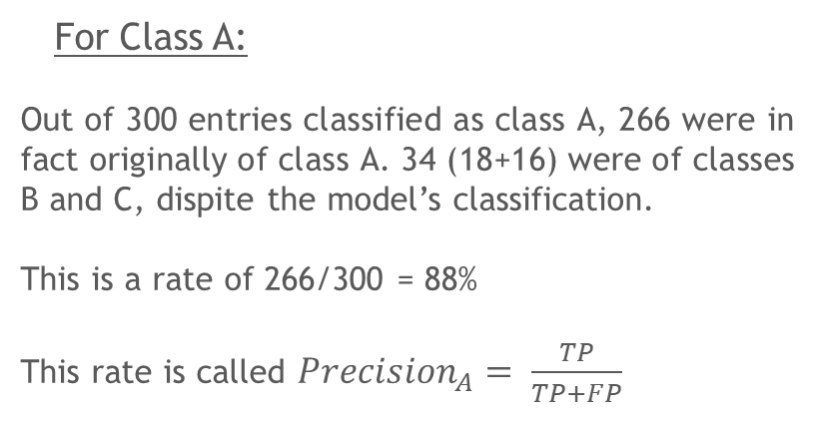
Machine learning workflow– Classification matrix
Lets say our Test set had 1000 entries…
Predicted Labels
(output of the model)
 | A
A | 266
B | 18
C | 16
Correct Labels
(provided in the data)
For Class A:
Out of 300 entries classified as class A, 266 were in fact originally of class A. 34 (18+16) were of classes B and C, dispite the model’s classification.
This is a rate of 266/300 = 88%
This rate is called ${Precision}_{A}= \frac{TP}{TP+FP}$
300

Slide 86
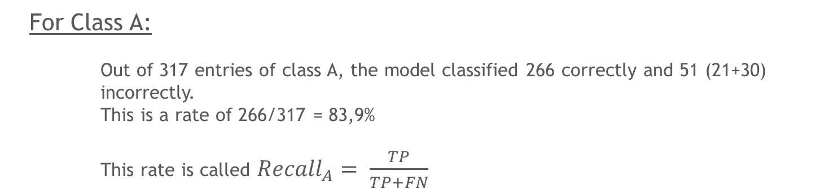
Machine learning workflow– Classification matrix
Lets use this to understand how good the model is for each class
Predicted Labels (output of the model)
 | A | B | C
A | 266 | 21 | 30
Correct Labels
(provided in the data)
317
For Class A:
Out of 317 entries of class A, the model classified 266 correctly and 51 (21+30) incorrectly.
This is a rate of 266/317 = 83,9%
This rate is called ${Recall}_{A}= \frac{TP}{TP+FN}$

Slide 87
Machine learning workflow– Classification matrix
Lets say our Test set had 1000 entries…
Predicted Labels (output of the model)
 | A | B | C
A | 266 | 21 | 30
B | 18 | 289 | 50
C | 16 | 10 | 300
317
Correct Labels
(provided in the data)
357
326
TOTAL: 1000
300
320
380

Slide 88
Machine learning workflow– Classification matrix
Lets imagine the example of Fraud Detection
Which do you think the client would prefer?
A – Fraud
B – Not Fraud
Predicted Labels
(output of the model)
Predicted Labels
(output of the model)
 | A | B
A | 21 | 1
B | 51 | 927
 | A | B
A | 2 | 20
B | 1 | 976
TOTAL1000
TOTAL
1000
Correct Labels
(provided in the data)
Correct Labels
(provided in the data)

Slide 89
Machine learning workflow– Classification matrix
Lets imagine the example of Fraud Detection
Which do you think the client would prefer?
A – Fraud
B – Not Fraud
Predicted Labels
(output of the model)
Predicted Labels
(output of the model)
 | A | B
A | 21 | 1
B | 51 | 927
 | A | B
A | 2 | 20
B | 1 | 976
TOTAL1000
TOTAL
1000
Correct Labels
(provided in the data)
Correct Labels
(provided in the data)
Trade off between
TP<->FN and even FP...

Slide 90
Machine learning workflow– Classification matrix
Lets imagine the example of Fraud Detection
We also cant have too high FP...
A – Fraud
B – Not Fraud
Predicted Labels
(output of the model)
 | A | B
A | 21 | 1
B | 927 | 51
TOTAL1000
Correct Labels
(provided in the data)

Slide 91
Machine learning workflow operations – Lets Review
0
Known data
1000

Slide 92
Machine learning workflow operations – Lets Review
0
Known data
Labels
1000

Slide 93
Machine learning workflow operations – Lets Review
0
Known data
Labels
0
Training Set
Labels
700
0
Test Set
Labels
1000
300

Slide 94
Machine learning workflow operations – Lets Review
0
Known data
Labels
0
Training Set
Labels
Validation Set
Validation Set
Validation Set
Validation Set
700
Validation Set
0
Test Set
Labels
1000
300

Slide 95
Machine learning workflow operations – Model Selection
Validation Set
Known data
Validation Set
Validation Set
Validation Set
Cross Validation
Validation Set

Slide 96
Machine learning workflow operations – Model Selection
KNN
Known data
SVM
Cross Validation
Regression

Slide 97
Machine learning workflow operations – Model Selection
KNN
?
Known data
=
SVM
?
Cross Validation
=
Regression
?
=

Slide 98
Machine learning workflow operations – Model Selection
KNN
?
Known data
=
Confusion Matrix,
TP, FP, FN, TN
SVM
?
Cross Validation
=
Confusion Matrix,
TP, FP, FN, TN
Regression
?
=
Confusion Matrix,
TP, FP, FN, TN

Slide 99
Machine learning workflow operations – Lets Review
0
Known data
Labels
0
Training Set
Labels
Validation Set
Validation Set
Validation Set
Validation Set
700
Validation Set
0
Test Set
Labels
Confusion Matrix,
TP, FP, FN, TN
1000
300

Slide 100
Machine learning workflow
Points of attention

Slide 101
Overfitting

Slide 102
Overfitting
In statistics, overfitting is "the production of an analysis that corresponds too closely or exactly to a particular set of data, and may therefore fail to fit additional data or predict future observations reliably"

Slide 103
Overfitting
WHAT?
In statistics, overfitting is "the production of an analysis that corresponds too closely or exactly to a particular set of data, and may therefore fail to fit additional data or predict future observations reliably"

Slide 104


Overfitting
Let’s imagine that you need to build a place for a person to sleep…
TV
Floor
Door

Slide 105
Overfitting
Please use Machine Learning to come up with the best furniture shape for a human to sleep BASED ON THE DATA THAT YOU HAVE

Slide 106
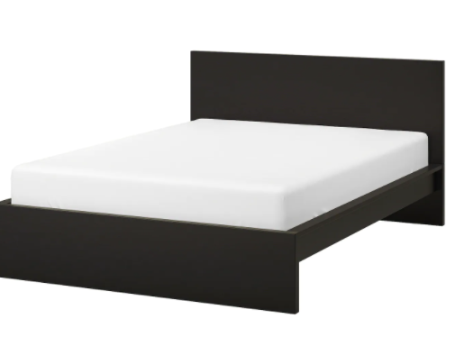
Overfitting
Please use Machine Learning to come up with the best furniture shape for a human to sleep BASED ON THE DATA THAT YOU HAVE
Intuitively, which is best?

Slide 107
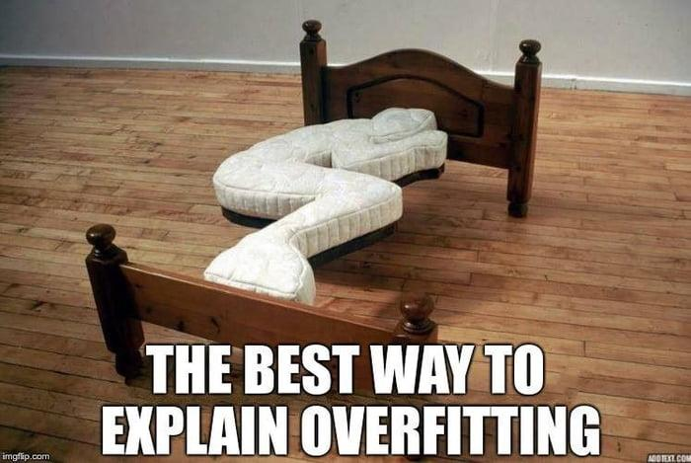
Overfitting
Please use Machine Learning to come up with the best furniture shape for a human to sleep BASED ON THE DATA THAT YOU HAVE
Intuitively, which is best?

Slide 108











Overfitting

Slide 109
Overfitting
New point

Slide 110
Overfitting

Slide 111
Overfitting
New point

Slide 112
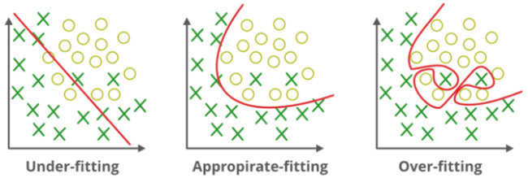
Overfitting

Slide 113
Overfitting
How do we cause overfitting?
Well, it depends a lot on the model!!!
Hence your need to understand it and not just using “model”.fit(X_train, y_train)
How do we identify overfitting
Comparing comparing the evaluation of your model between the training labels and the test labels

Slide 114
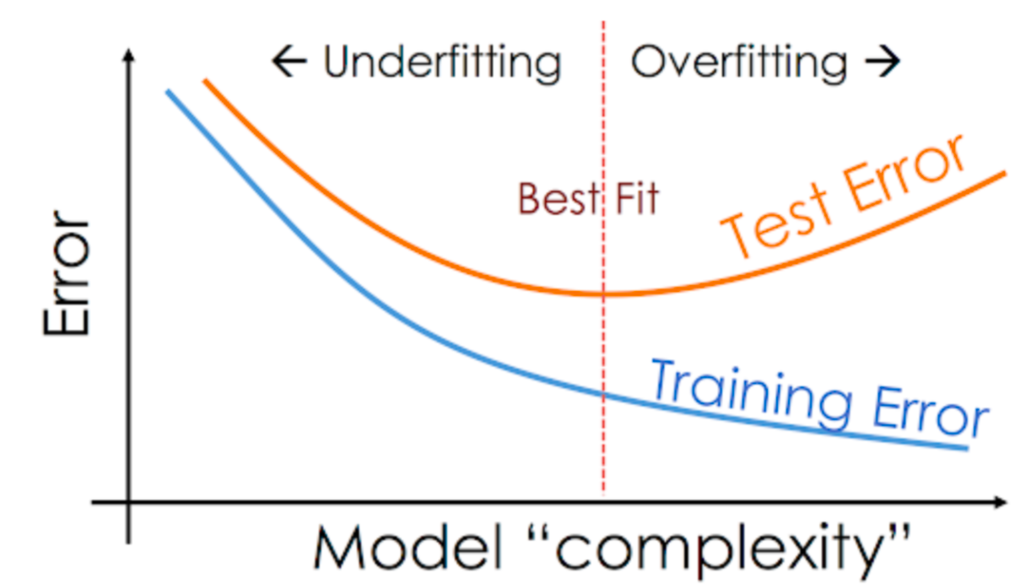
Overfitting

Slide 115
ML WORLD
LAB

Slide 116
Thank you

Slide 117
Supervised Learning
Review and applications

Slide 118
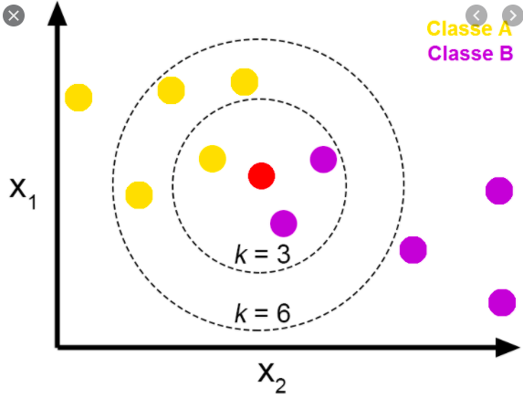
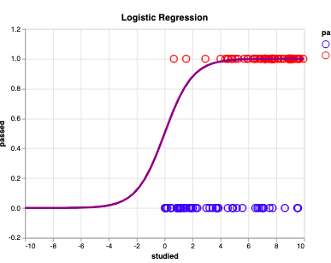
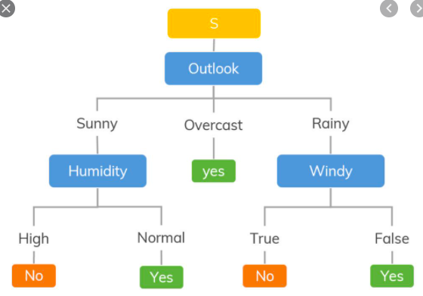
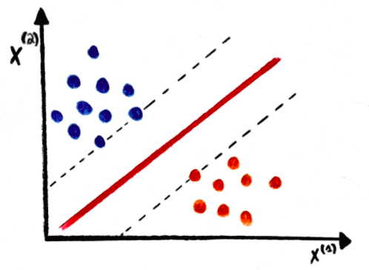
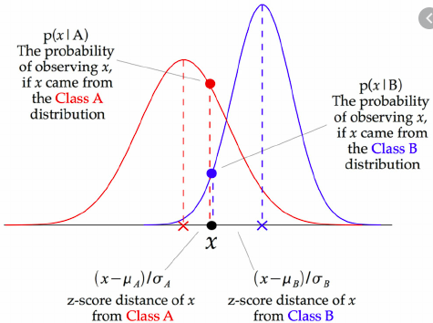
Machine Learning Models
There are many machine Learning Models…

Slide 119
Machine Learning Models
There are many machine Learning Models…
You DONT NEED TO KNOW
how to code/build them.
!BUT!
The more UNDERSTAND THEM,
the better you will know
what “CHOICES”
make sense
(e.g, Normalize or not, take care with overfit, etc)

Slide 120
Machine Learning Models
Let’s simplify
Features
Label
Training data
Model
(e.g, KNN – 4nighbors)
Label of the datapoint we were aiming to predict
Label = 4
Data I want to guess the label
(Goal of Machine Learning

Slide 121
Machine Learning Models
Let’s simplify
Features
Label
Training data
[model].fit(X_train, y_train)
label= [model].predict(new_point)
It is “ok” that this is a black box to you in terms of code
Label of the datapoint we were aiming to predict
Label = 4
Data I want to guess the label
(Goal of Machine Learning

Slide 122
Machine Learning Workflow - Choices
Data Processing
&
Feature Selection
Training
Model Selection
Testing
Quality of Model
”Real Life”
Data
Trained
Model
Label

Slide 123
Machine Learning Workflow - Choices
All features
Normalized
Model options
Cross Validation
Pick the best
KNN (3)
KNN (5)
...
KNN (19)
SVM (c=0.01)
SVM (c=0.1)
…
SVM (c=10)
NB()
DT(max_depth=4)
DT(max_depth=5)
…
DT(max_depth=20)
Cv_{acc} = 0.92
Cv_{acc} = 0.89
...
Cv_{acc} = 0.76
Cv_{acc} = 0.95
Cv_{acc} = 0.90
…
Cv_{acc} = 0.56
Cv_{acc} = 0.67
Cv_{acc} = 0.83
Cv_{acc} = 0.77
…
Cv_{acc} = 0.92
Standardized
Non Transformed
?
Testing
Selected
Features
Normalized
Standardized
Quality of Model
Non Transformed

Slide 124
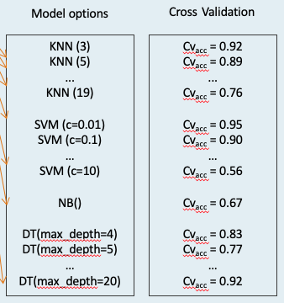
Machine Learning Workflow - Choices
Model options & Cross Validation
All features
Normalized
Pick the best
Standardized
Non Transformed
Feature Selection
Standardizing them
KNN(19)
Testing
Selected
Features
Normalized
Standardized
Quality of Model
Non Transformed

Slide 125
Machine Learning Workflow
EXERCISE IN COLAB

